Slide 1

COPY WWW
APOORVA PANDEY Admission No.: 15SECE103053
KARTIKAY SINGH Admission No.: 15SCSE101125
PRASHANT KUMAR SINGH Admission No.: 15SCSE101170
VINAY RAGHAV Admission No.: 15SCSE101254

Slide 2
ABSTRACT
This project discusses about an application which will copy the files like the operating system but in a different manner.
We copy various large files and we get an error and then we have to start from the starting. Keeping all things in mind this application has features to resume the copy file from where it failed.
Copy WWW tries to include most of the features of Super Copier into a completely multi-platform program. In this application various shortcomings of operating system have been covered.
We will try to add a feature along with Copy WWW that is to provide a website offline which is static. When website will be in offline mode you can easily search or browse through it without any internet connection and hence making your tech life quite easily.

Slide 3
INTRODUCTION
Overview
This project discusses about the implementation of a copier software that will copy your files in more reliable way.
This project is made in java and has been embedded to make an android application.
There are various functions of java used in our project including abstraction, encapsulation and polymorphism.
When you choose 'Copy this file' from the move or copy dropdown, you will then be able to select which project to copy it to. You can copy the file to the existing project, or to a different one.
When website will be in offline mode you can easily search or browse through it without any internet connection and hence making your tech life quite easily.
This feature will help people to search or browse the information if they have used this feature previously on some website.

Slide 4
II. Background and Motivation
Apart from doing various input output operation it comes with handy amount of security functions and protection against your data.
One more major function of operating system is to copy files from one directory to another.
There are various shortcomings when it comes to copy files like, we can’t resume the files after cancellation during copy.
In this all new software we can eradicate all this shortcoming for a better flow during move/copy operation. What follows is the various function of this software.
• Treatment of the transfers one after the other
Add new transfers to the queue while a copy is already being processed
Dynamic management of the queue of remaining transfers

Slide 5
It will give you access to search or browse through any webpage without internet connection.
It saves time and can be easily run irrespective of your mobile network strength.
Helps to search the data in the minimum time.
Gives you access to have the data of the website 24*7.

Slide 6
OVERALL DESCRIPTION
Problem Statement
While copying files through operating system we face many issues like time consuming, loss of data, can’t resume the copy operation in between the process, we can’t skip redundant data etc.
These problem statements are covered in our proposed statement. While transferring of large files we may get annoyed if we get error and hence it’s very time consuming.
Our proposed software includes every features of Super copier (Windows only software). In addition, it contains various features which are as follow.
Skip current transfer to proceed to the next one
Resume a copy at the exact point where it failed (no need to start over)
Choose another name for the target if a file already exists

Slide 7
Can follow or ignore symbolic links (Unix systems only)
Set a default behaviour if target file already exists
Keeps track of the transfers which failed.
Treatment of the transfers one after the other
Add new transfers to the queue while a copy is already being processed
Dynamic management of the queue of remaining transfers
Pause a copy
Limit the speed of the copy
It will give you access to search or browse through any webpage without internet connection.
It saves time and can be easily run irrespective of your mobile network strength.
Helps to search the data in the minimum time.
Gives you access to have the data of the website 24*7

Slide 8
PURPOSE
Purpose of this project is to save time while transferring large amount of data.
Big companies need such software as they have to transfer large amount of data to their directory.
In case if it fails through operating system they have to start from the beginning.
Hence this software can be a great asset for them as it will help them to encounter such problem.
The installation with Windows should be straightforward. If you use the archive version, there is no need of installation, however you will need the Java Virtual Machine (Java Runtime Environment 5.0 minimum).
This software is very reliable if we will compare it with another software. There is no software available in the market which can make the transfer of file easy.

Slide 9
MOTIVATION AND SCOPE
In a given time frame, we can induct various features in this project along with all the above features mentioned to make a more reliable software easily.
There are various shortcomings when it comes to copy files like, we can’t resume the files after cancellation during copy. We can’t skip the present ongoing files even though we don’t want it to be copied.
You can launch Copy WWW with the script included in the archive. It is also possible, depending on your distribution, to right-click on the CopyWWW.jar file, and “Open with Sun Java 5.0 Runtime”.
Drag and drop files or folders you wish to copy on the basket icon. You can do this several times, send multiple files simultaneously… When you want to paste the basket content, just drag and drop a destination folder on the icon on the right.
While queue is being processed, you can, at any time, pause the copy, skip current transfer to proceed to the next one, or manage queue composition.

Slide 10
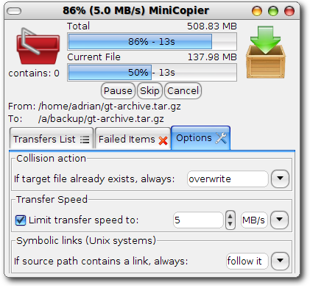
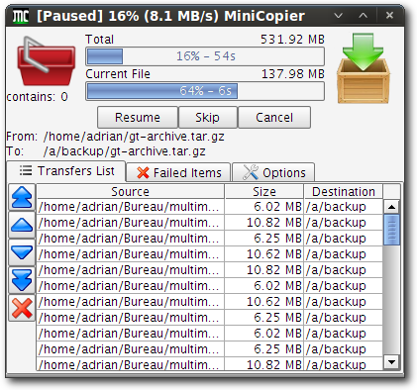
MODULE SPLIT UP
Our project is basically an application which is having various java files of different module as well as jar file.
Our project contains lib, src, xml, sh script. It also includes GUI in which there are having many modules. Below image shows our project files.

Slide 11
GANTT CHART

Slide 12
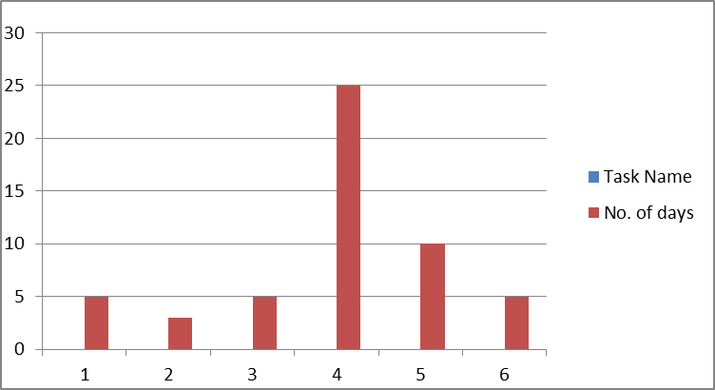

Slide 13
REFERENCES
JavaTpoint- https://www.javatpoint.com/
You tube
Java Concurrence in practice- Brian Goetz
GeeksforGeeks

